Slide 1
Tutorial 1 Notes

Slide 2
Q1

Slide 3
Step 1 – Understand the problem
What’s a prime?
A prime number is a positive integer greater than 1 that has no positive divisors other than 1 and itself.
Example: 7 is a prime number because its only divisors are 1 and 7.
Other examples: 2, 3, 5, 7, 11, 13, 17, 19, 23, … …

Slide 4

Step 2- How do you find a solution?
Convert the problem into description of input and output.
Input: a positive integer $n$.
Output: "Yes" if $n$ is prime; "No" otherwise.

Slide 5
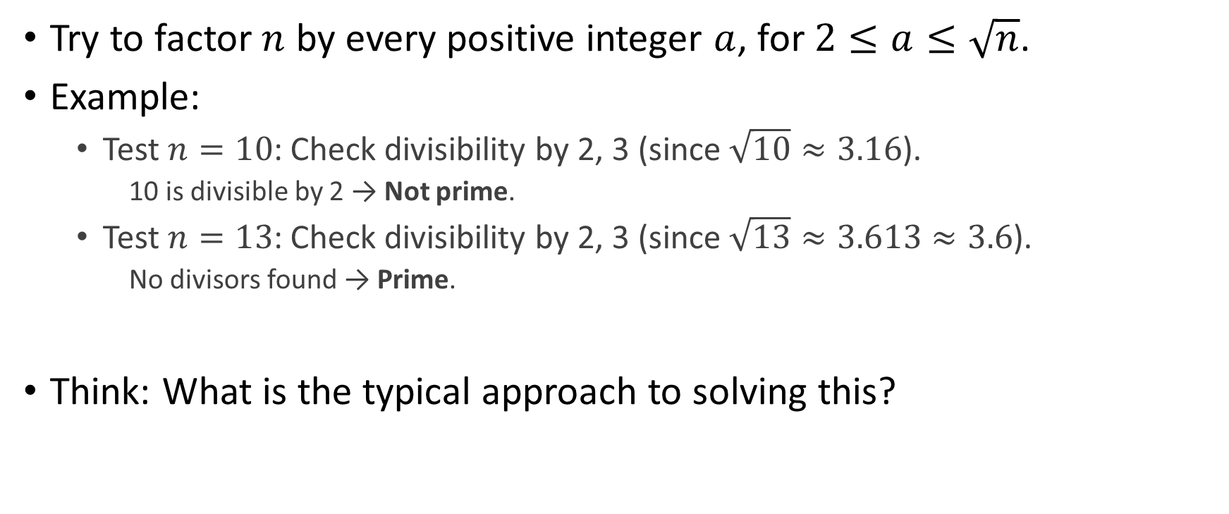
Step 3 – High-level thinking and presentation
Try to factor $n$ by every positive integer $a$, for $2≤a≤\sqrt{n}$.
Example:
Test $n=10$: Check divisibility by 2, 3 (since $\sqrt{10}≈3.16$).
10 is divisible by 2 → Not prime.
Test $n=13$: Check divisibility by 2, 3 (since $\sqrt{13}≈3.613​≈3.6$).
No divisors found → Prime.
Think: What is the typical approach to solving this?
Notes:
尝试用每一个满足条件的正整数a来分解n

Slide 6
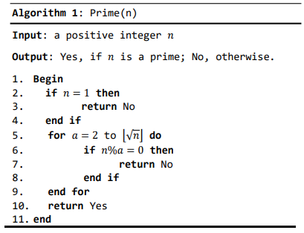
Step 4 – Work out the pseudo code
Notes:
强调一下写伪代码时必须要有规整的格式。

Slide 7
Q2

Slide 8
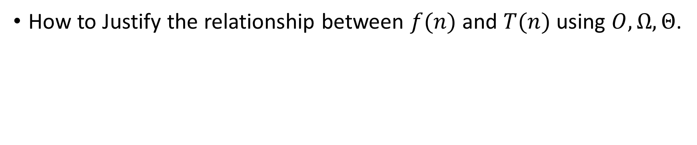
Analysis
How to Justify the relationship between $f(n)$and $T(n)$ using $O,Ω,Θ$.
Step 1: Think about “Is the conclusion correct?”
Step 2: If it is, use definitions, laws and theorems taught to justify.
Step 3. If not, take a counterexample.
Note that we can determine the correctness of this conclusion by using L’ Hospital’ s Rule (In some specific situations) or considering extreme examples, etc.

Slide 9
Q2a.
Yes. The conclusion is correct.
Using definitions, laws and theorems to prove it.

Slide 10
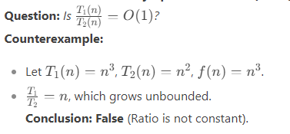
Q2b
No. It’s incorrect. And Take a counterexample.

Slide 11
Q2c
No. It’s incorrect. And Take a counterexample by yourself.

Slide 12
Q3

Slide 13
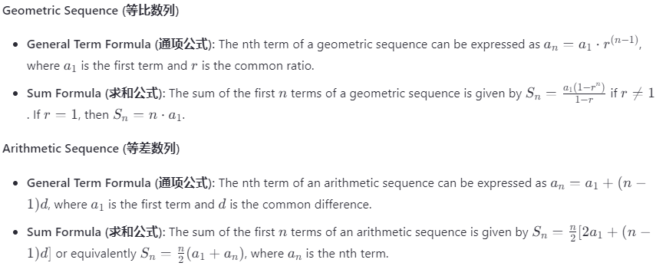
Prior knowledge

Slide 14
Attention
For the question like “Solving the recurrence relations”,
it is NOT permissible to directly apply the master theorem in our exercise, homework assignments, etc.; an iterative approach must be used.

